Slide 1
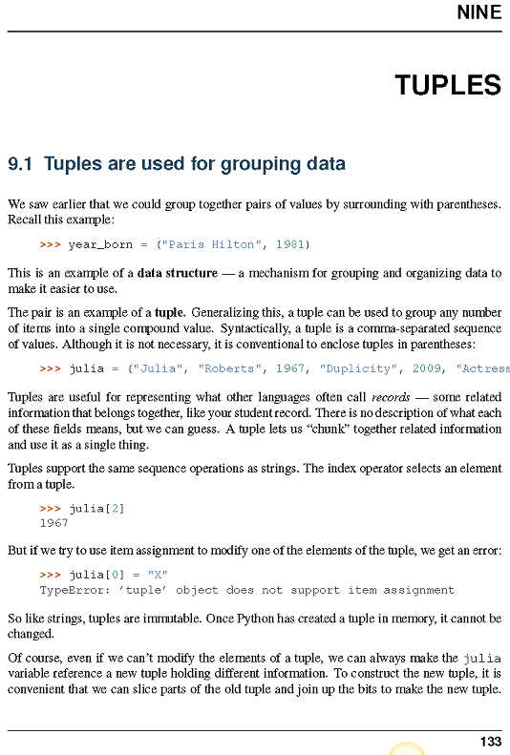

Slide 2
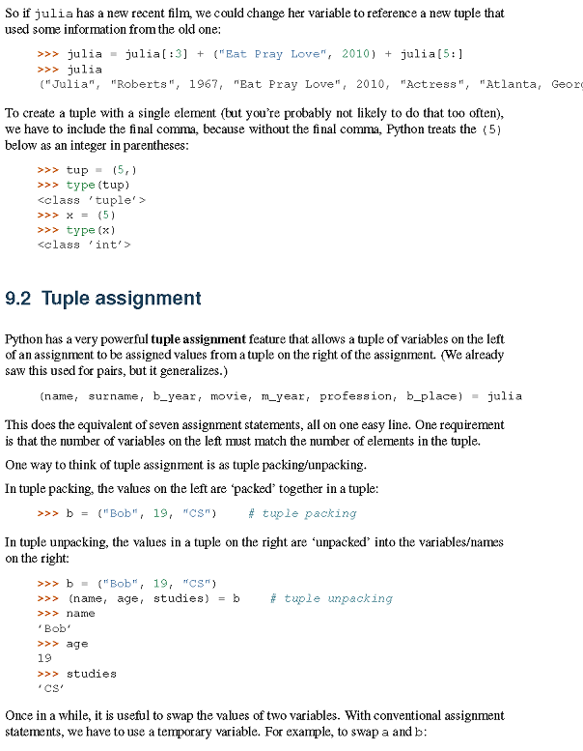

Slide 3
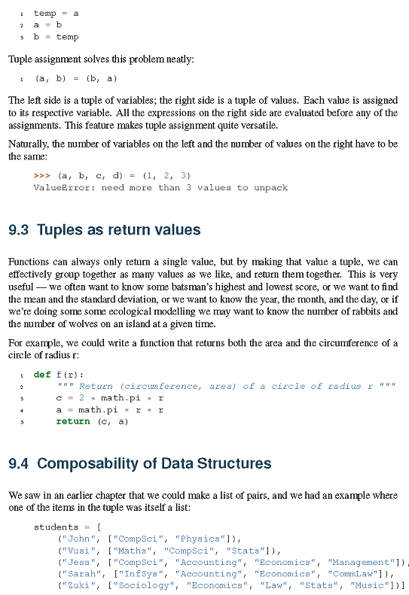

Slide 4
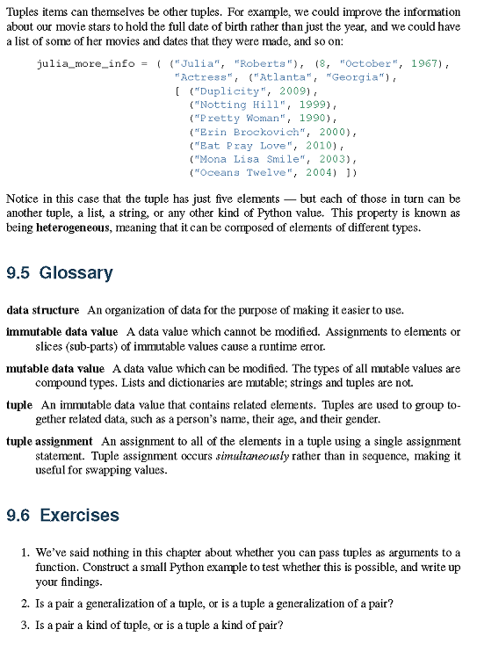

Slide 5
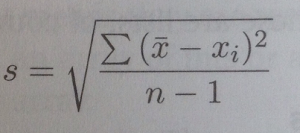
Ws ch9_1
Write a function, Fibonacci(n), which returns a list of the first n terms of the Fibonacci series, n >= 2
1,1,2,3,5,8,13….
WS ch 9_2
Of the first 40 Fibonacci numbers, which of these are prime numbers?
WS ch 9_3
Write a function, mean_std_dev(data), where data is a tuple of number, and which returns a tuple consisting of two numbers: the mean of the data and the standard deviation of the data.
The mean of the data is just the average of the data.
Standard deviation, s is defined as:
Use your functions to find the mean and standard deviation of the data
(1.01,1.03,0.98,0.97,0.99,1.04)

Slide 6
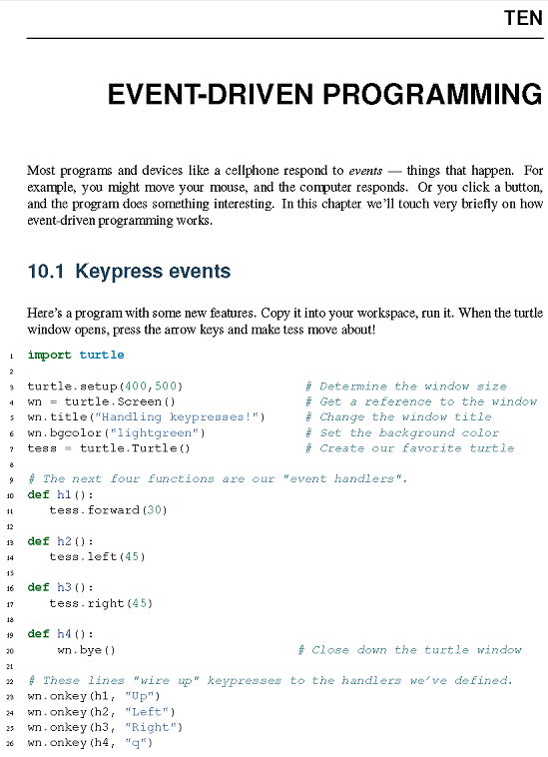

Slide 7
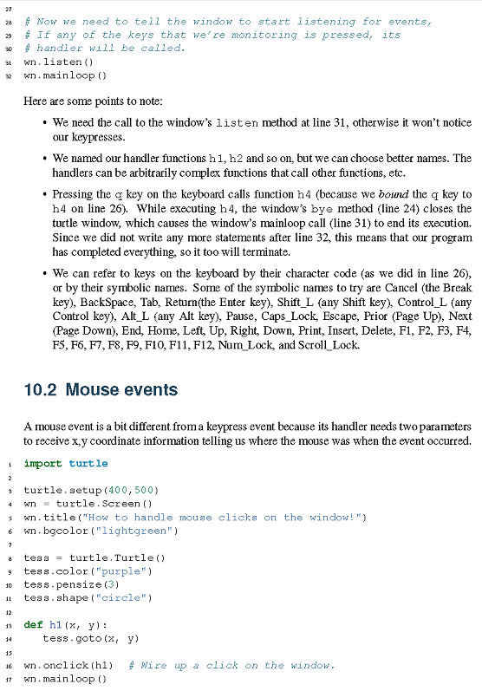

Slide 8
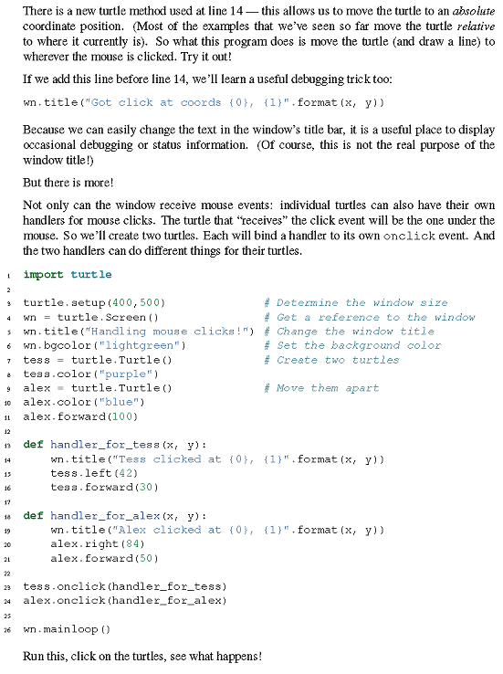

Slide 9
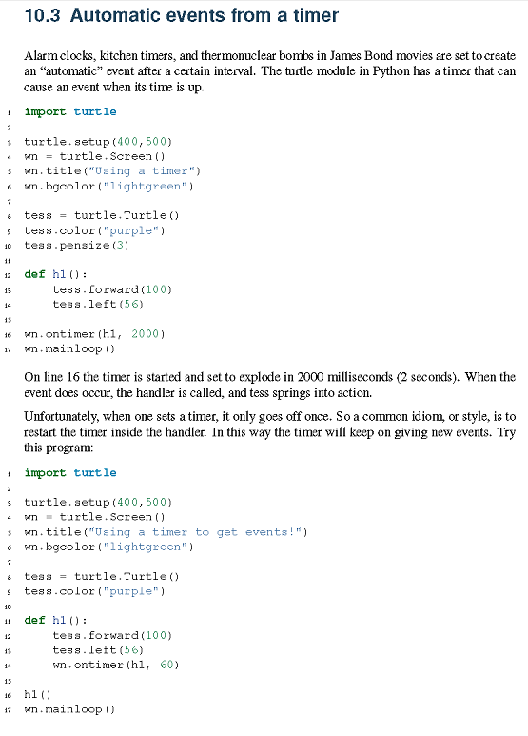

Slide 10
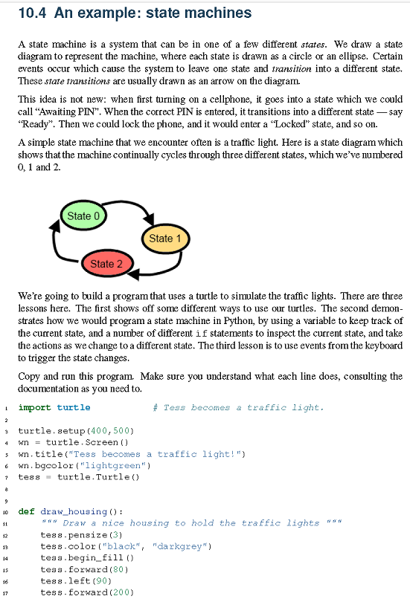

Slide 11
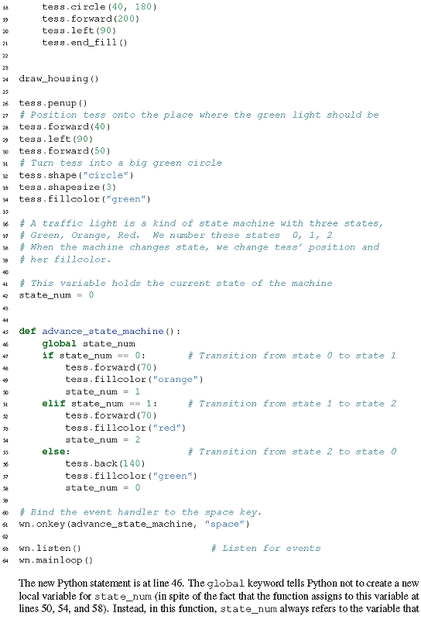

Slide 12
WS ch10-1
Take the last traffic light example & modify it so that the light is green for 5 s, yellow for 1 s, and red for 7 s. Use the sleep command from the time module. Make the light complete 3 cycles.

Slide 13
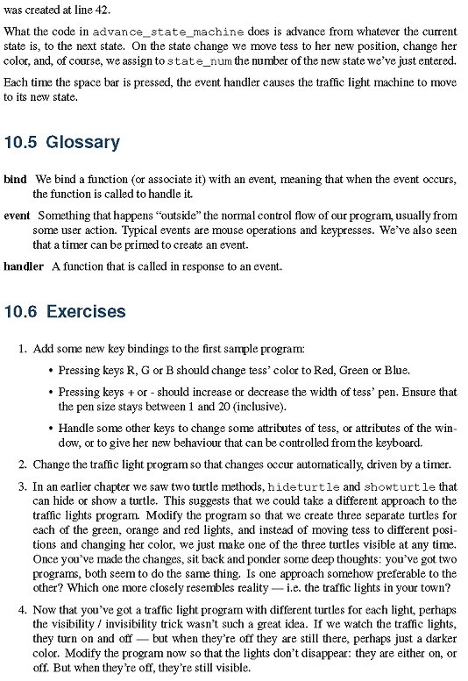

Slide 14
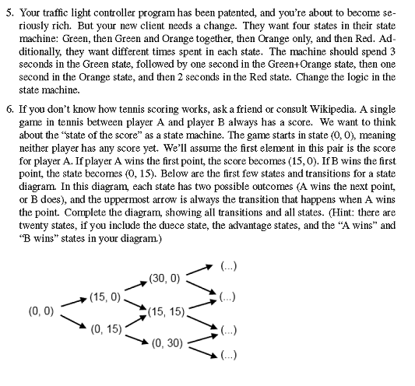

Slide 15
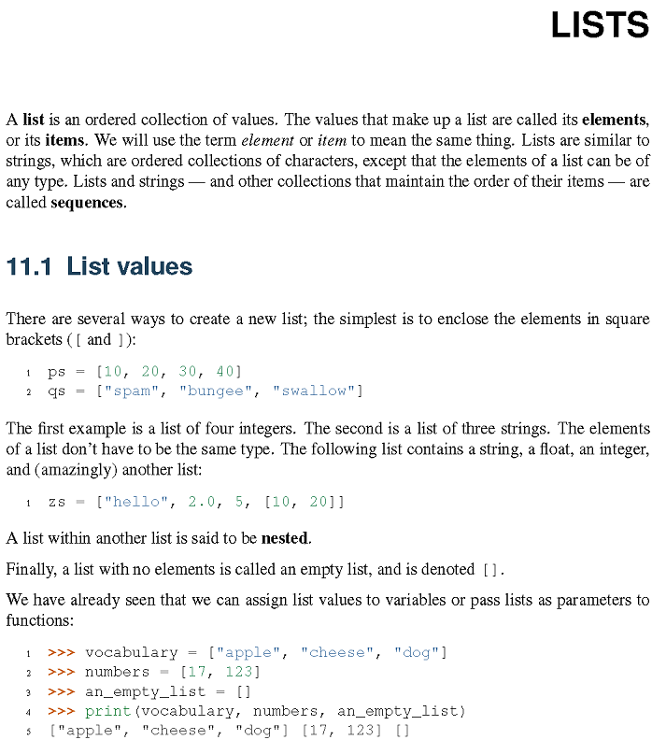

Slide 16
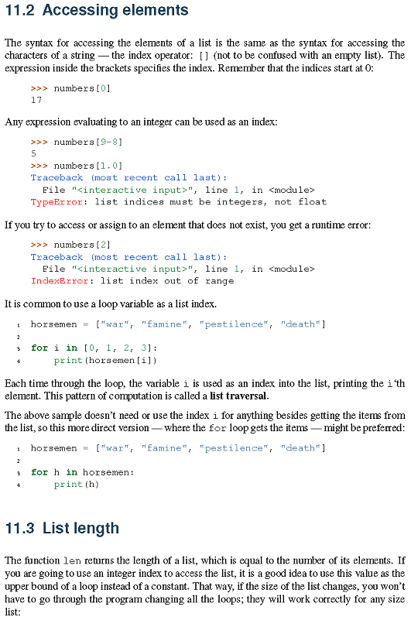

Slide 17
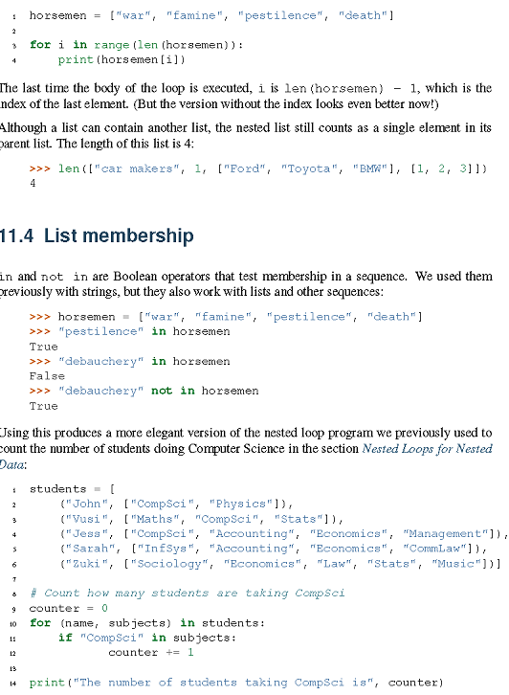

Slide 18
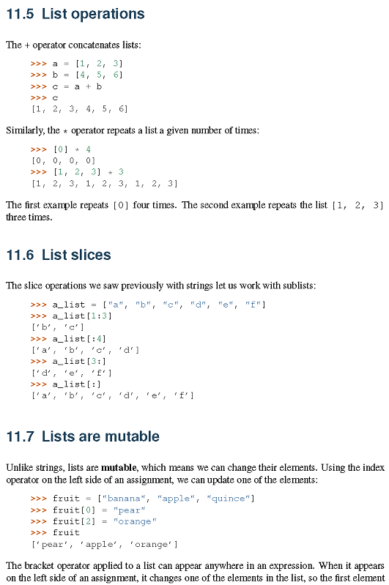

Slide 19
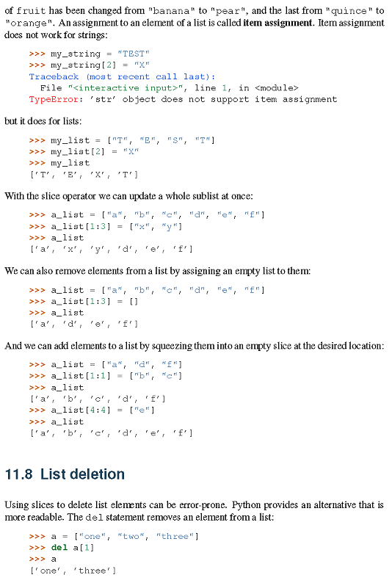

Slide 20
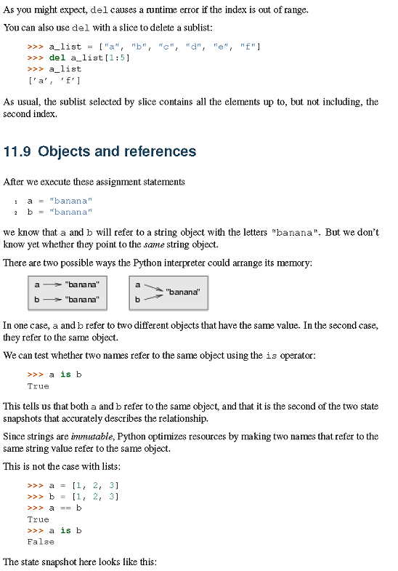

Slide 21
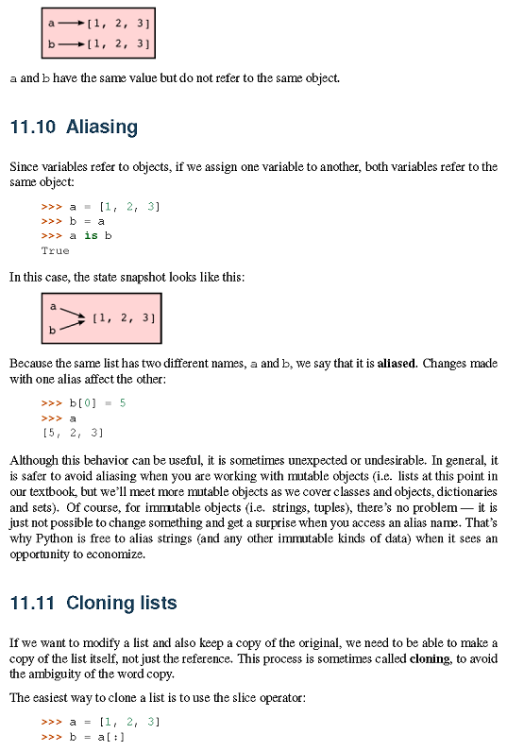

Slide 22
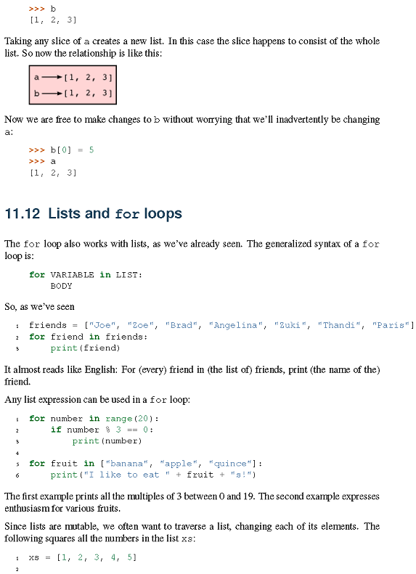

Slide 23
Ws ch11_1
Write the function primes_lessthan(n), which return a list of all the primes <= n, where n is an int.
Ws ch11_2
Write a function, sumOfPrimesLessThan(n), which returns the sum of the primes less than n.
Ws ch11_3
Write a function, primesWithAPrimeDigitSum(n),
Which returns a list of primes less than n that have a prime digit sum. Find all primes
less than 1000 which have a prime digit sum. Of these primes, which one(s) have the largest digit sum?
Ws ch11_4
What ints between 5000 and 10000 are odd, divisible by 29 and do not contain any even digits? How many such ints are there? Which of these ints are within 2 of a prime? How many such ints are there?

Slide 24
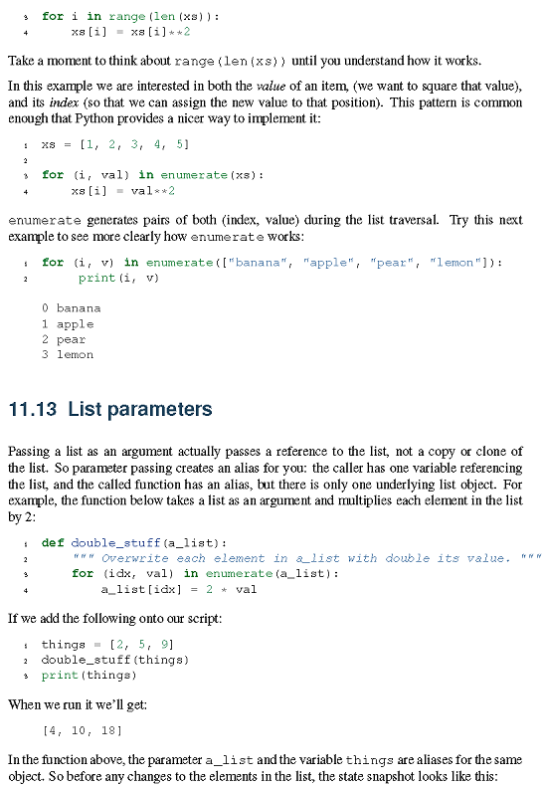

Slide 25
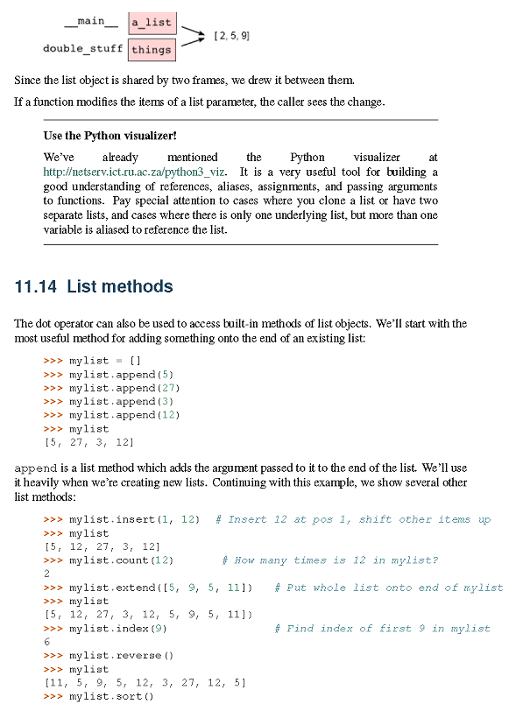

Slide 26
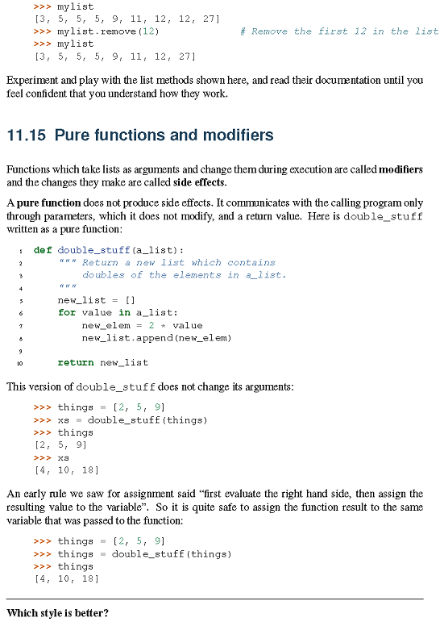

Slide 27
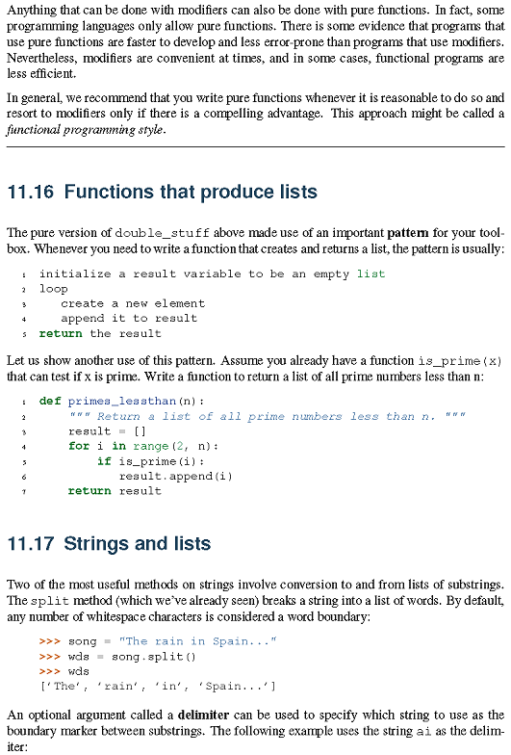

Slide 28
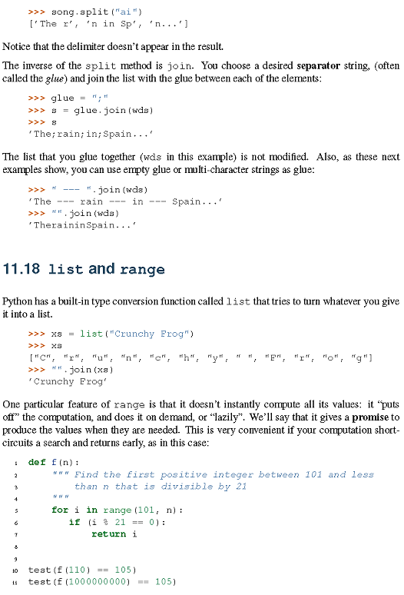

Slide 29
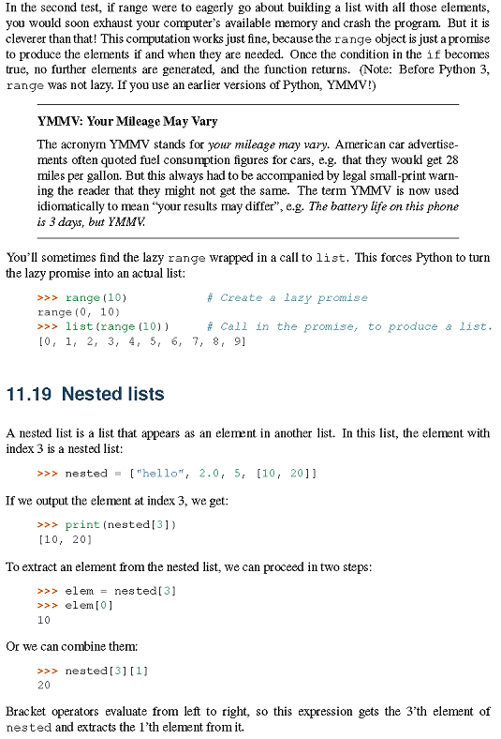

Slide 30
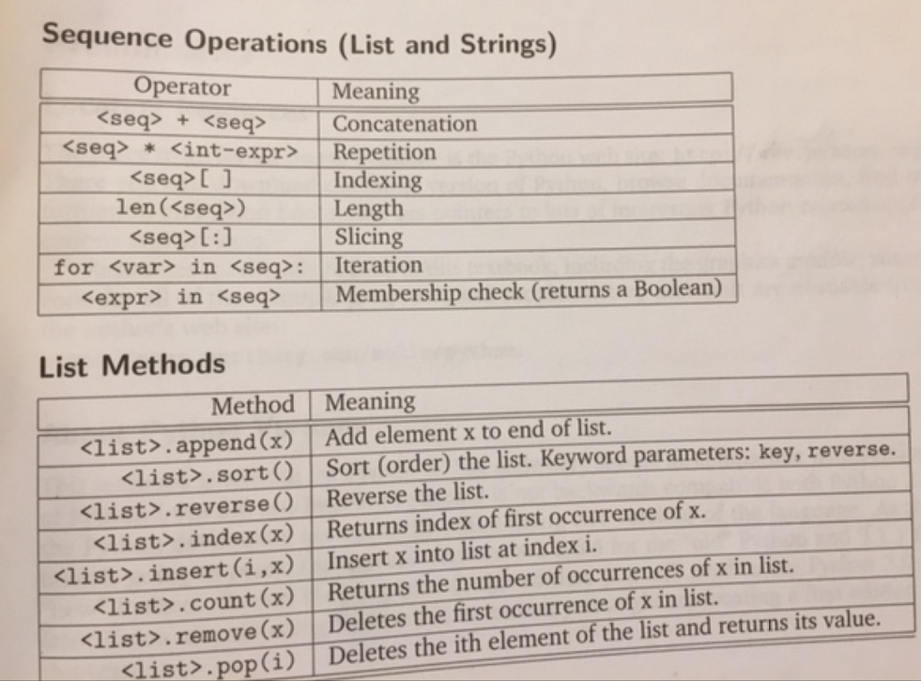
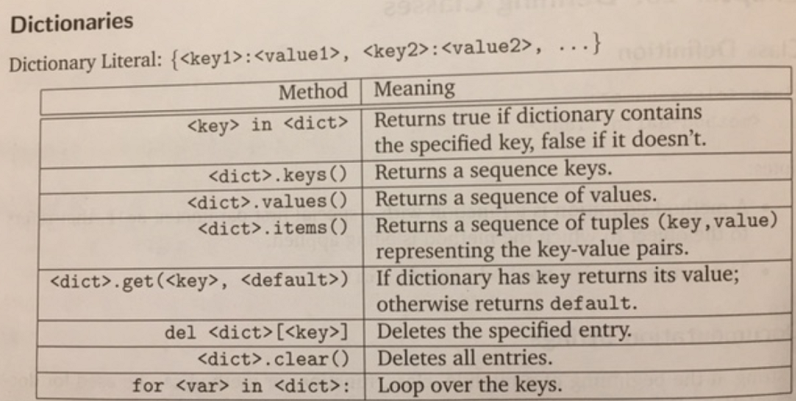

Slide 32
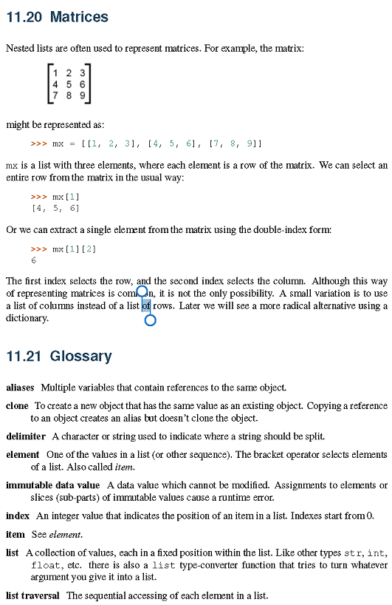

Slide 33
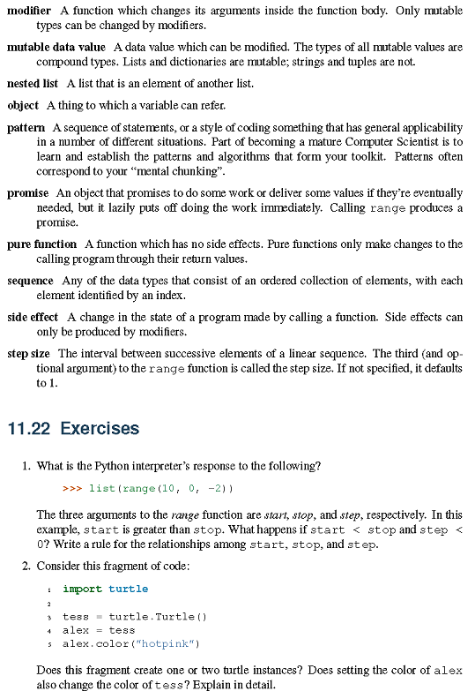

Slide 34
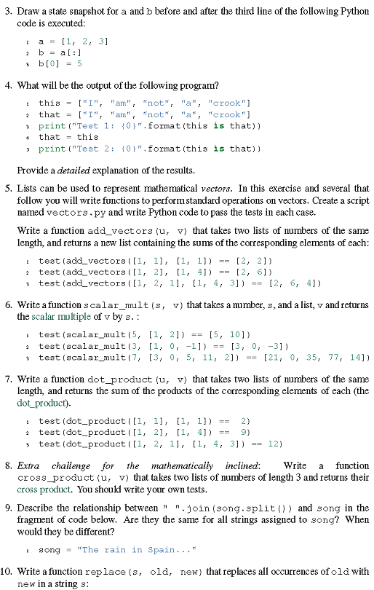

Slide 35
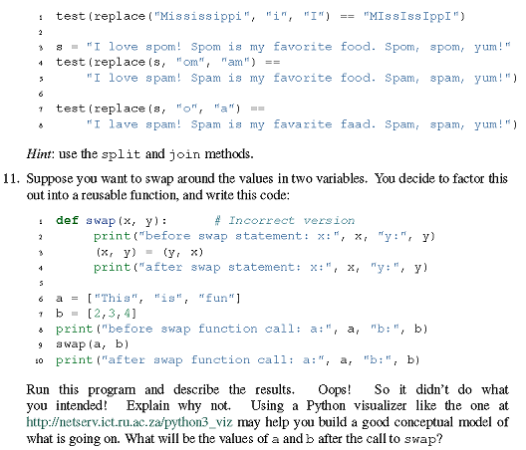

Slide 36
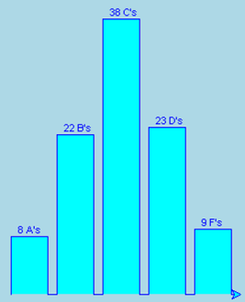
HW
Ch 10 Ex: 2,3,4,5
yt problem follows:
Write a function, grade_histogram(t,mu,sigma,n), which uses the turtle module to make a histogram for quiz score data for n = 100 students. First, create the data using gauss(mu,sigma), from the random module. mu is the average and sigma is the standard deviation of the scores and is a measure of the spread of the data scores. When the quiz data is generated, check to make sure that each quiz score is between 0 and 100, inclusive. Put the data into a list. Take the data you generated with the specified mean and standard deviation & make a histogram of the number of A’s, B’s, C’s, D’s and F’s, according to the following rubric:
A: 95 <= score <= 100
B: 85 <= score < 95
C: 75 <= score < 85
D: 65 <= score < 75
F: score < 65
Use appropriate helper functions to make your code easy to write and easy to read.
Scale the histogram height so the maximum height is 300 turtle steps. Your code should have output like the sample shown below which uses 100 students with mu = 80 and sigma = 10, and which includes the labels shown on top of each of the histogram bars. Note that the number of A’s, B’s, C’s, D’s and E’s must equal to n.
grade_histogram(alex,80,10,100)

